Slide 1
“Introduction”

Slide 2
Revelation: 26 Weeks Schedule
Jan 7: Introduction
Jan 14: Date Written¹
Jan 21: Date Written²
Jan 28: Tribulation,12¹
Feb 4: Ch. 1
Feb 11: Ch. 4, 5
Feb 18: Ch. 6, 7¹
Feb 25: Ch. 7²
Mar 3: Ch. 8
Mar 10: Ch. 9
Mar 17: Ch. 9 “5 Sins”
Mar 24: Ch. 10
Mar 30: Ch. 11, 12²
Apr 7: Ch. 13¹
Apr 14: Ch. 13²
Apr 21: Ch. 14, 15
Apr 28: Ch. 16¹
May 5: Ch. 16²
May 12: Ch. 17¹
May 19: Ch. 17²
May 26: Ch. 17³
Jun 2: Ch. 18
Jun 9: Ch. 18
Jun 16: Ch. 19
Jun 23: Ch. 20
Jun 30: Ch. 21

Slide 3
Class Format
Facts spoken somewhat frankly
Will take time for discussion
Many Revelation verses are self-explanatory
“Revelation Characteristics”
Handout – email questions & comments
Course requires you to think
Download PowerPoint slides
PowerPoint slides (*.pptx)
Zipped file of slide images (*.zip)
Notes:
Frankly spoken facts
Facts aggravated at times? Possibly. Not a problem.
“Pain is weakness leaving the body.”
In Revelation, “Aggravation is Oral Tradition leaving the brain.”
Many verses self-explanatory
Won’t insult your intelligence by covering those
Revelation Characteristic
Informative, enjoyable, and entertaining manner
Questions/Comments
See Wednesday night sheet for Email address
Will ask questions from time to time: Answering is fine, but be logical and be prepared to support your answer
Index cards handed to me with questions or comments is fine, too

Slide 5
Revelation: Sample of Revelation Topics
Oral Traditions
Forbidden Zone
Theme
Understandable
Premillennialism
Pre-M Mindset
Pre-M Contradictions
Revelation Sources
Inspiration
Date Written
Name of Book
Translators’ Biases
Lord’s Day
Scroll with Seals
Apocalypse
Numerology
Symbolism Figurative
Literal Tribulation
24 Elders
4 Creatures
4 Horsemen
5 Accusations
144,000
Bias vs. Context
Egypt, Babylon
Harlot in Purple
“What’s New”
“Mark of the Beast”
Receiving MoB
Armageddon
Witch of Endor
1000 Year Reign
7 Kings + 1
10 Kings
Kings of the Earth
Working Knowledge Kings of the Earth
Anti-Christ
Proof
Evidence
Caesar Worship
“Reign”
Heaven’s Population
“If you have an ear”
“Song of Moses”
“Song of the Lamb”
Afterlife

Slide 6
“Revelation Characteristics”
Intend To Discuss
Genesis vs. Rev.
The Lost Ark
Pre-M Disasters
Pompeii
“Heaven or heaven”
Afterlife
Hell’s Population
Poetic License
Hymns vs Rev.
Hymns vs. Pre-M
Missing Tribes
Why We Suffer
Probably Will Discuss
Karma
Out of Order
Out of Context
We Don’t Own Hymns
R. I. P.
Guilt by Association
Where is Paradise
Abyss vs. Torment
Credit Cards
Advanced Class
Can We Sin In Heaven
Statistical Sampling
Revenge vs Avenge
Dead Sea Scrolls
CoC Not Understand
Vulgate MoB
Rapture
Restore
Opinions
P. Tactics
Teaching
All topics relate to Revelation
Notes:
Some topics reserved for advanced class.
Topic may require a working knowledge of Revelation to discuss.

Slide 7
“Advanced” Revelation Class
~13 weeks class (1 quarter)
Lots of discussion and interaction
Need working knowledge of Revelation
Confidential discussions and information (no recordings)
How to teach Revelation
Difficulties encountered and how to overcome them
Proofs, evidence, issues encountered
Discussing Revelation with a Premillennialist
Premillennialists’ tactics
Limited knowledge
Discuss Revelation with a members of CoC
Issues encountered, “Oral Traditions”
Intent, Results
Things CoC does not understand
Notes:
Some topics reserved for advanced class.
Topic may require a working knowledge of Revelation to discuss.
Confidential discussions concerning teaching Revelation:

Slide 8
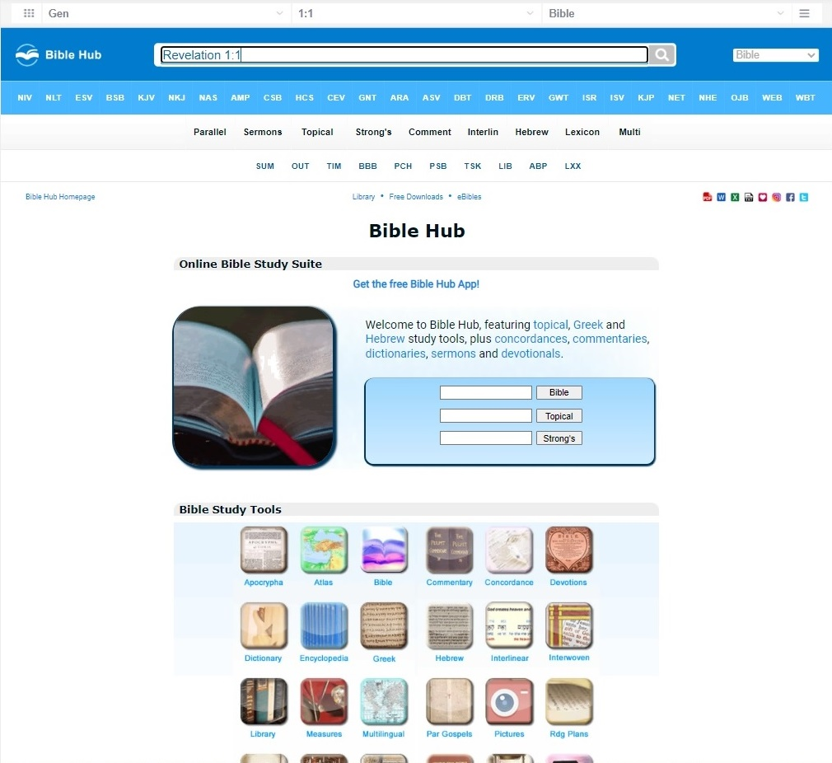
“biblehub.com”

Slide 9
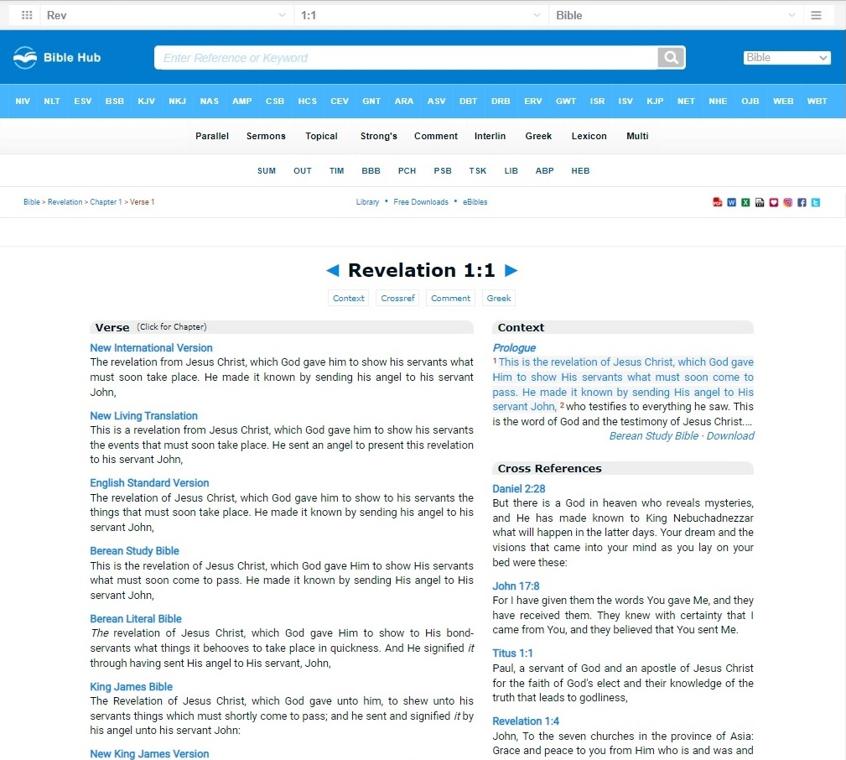
“biblehub.com”

Slide 10
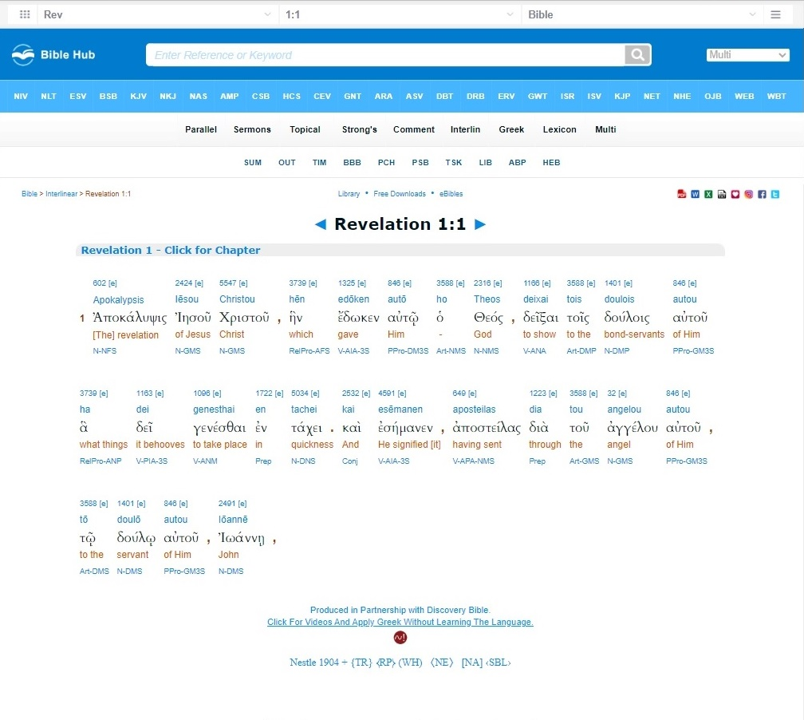
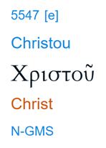
“biblehub.com”
X-Refs
Transliteration
Greek
Translation
Greek PoS
Notes:
X-Refs: “Summary”
Strong’s Exhaustive Concordance
NAS Exhaustive Concordance
Thayer’s Greek Lexicon
Englishman’s Concordance
Greek Parts of Speech
Part of Speech
Person
Tense
Mood
Voice
Case
Number
Gender
Comparison

Slide 11
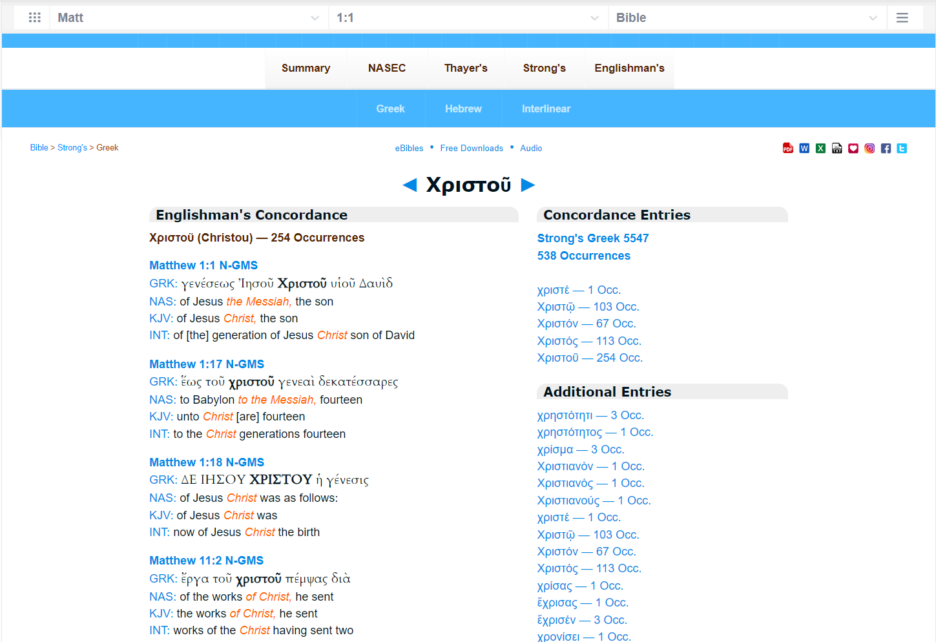
“biblehub.com”

Slide 12
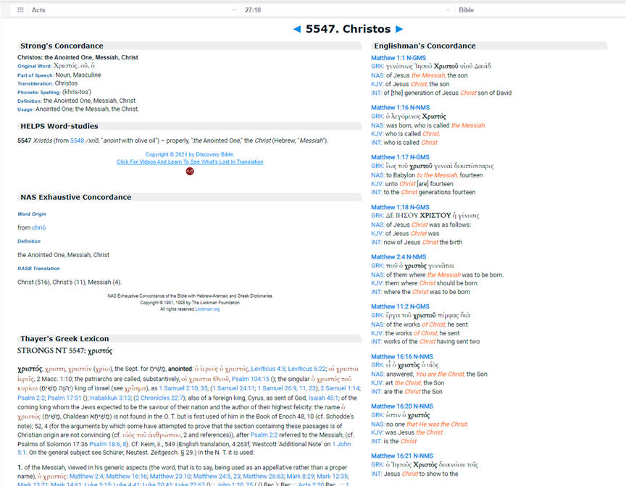
“biblehub.com”

Slide 13
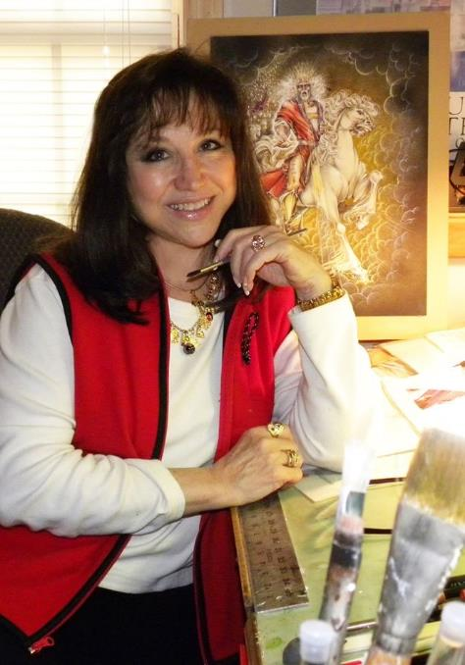
“Revelation Illustrated”

Slide 14
Notes:
Revelation 20:12
And I saw the dead, small and great, stand before God; and the books were opened: and another book was opened, which is the book of life: and the dead were judged out of those things which were written in the books, according to their works.

Slide 15
Why Study Revelation
Understand Revelation to extent possible
Think independently of “Oral Traditions”
Counter oral traditions & errors taught
Develop independent working knowledge
Equip with Revelation proofs and evidences
No longer ignore “Forbidden Zone”
Know definitely why Christians suffer
Deeper insight into hymns
Prove no new doctrine in Revelation
God’s view of unrepentant sinner
Relationship between Revelation verses
Foundation to build future knowledge
How to and how NOT to research Revelation
Notes:
2 (think independently of oral tradition)
Think independently of “Oral Traditions”
Need working knowledge + evidence
Start learning & practicing proofs and evidences in this class
“It doesn’t matter what I think. It only matters what I can prove.” - Lead lawyer on movie A Few Good Men
Pain is weakness leaving the body. Aggravation is oral tradition leaving the brain.
3 (counter incorrect interpretations)
Counter Pre-M & mindset
Discuss Revelation with emphasis on countering Pre-M
Countering Pre-M requires evidence or proof
Example of Armageddon being or not being end of world
Versus 1000 Year Reign
6 (forbidden zone)
You cannot make an intelligent statement on Revelation and ignore the “Forbidden Zone” at the same time
“Forbidden Zone” is where all the answers are
7 (suffer)
3 chapter trilogy in Revelation
First chapter – historical suffering from O.T.
Second chapter – (1) why we suffer today, (2) how it all got started
Third chapter – details of suffering during setting of book of Revelation
8 (hymns)
"Living By Faith"
Old: The Lord will return to "to this earth" some sweet day.
New: The Lord will return to "for the saved" some sweet day.
“Sing The Wondrous Love Of Jesus"
Old: When we all get to heaven.
New: When the saved get to heaven.
Hymns which may or may not be consistent with Revelation
Poetic license vs. accuracy
Jesus is the Rose Of Sharon, Lily of the Valley
Versus contradiction of scripture
Most hymn authors are Methodist, Pre-M
Hand-waving and re-interpret
Some issues are too blatant to dismiss
Ignorance is NOT bliss
We are singing to our visitors
Can’t teach others falsely thru hymns
Just like we can’t thru our sermons and Bible classes
9 (no new doctrine)
Revelation takes doctrine you already know and gives you specific examples of it

Slide 16
Objectives of Studying Revelation
Objectives
Determining meaning based upon evidence:
Consistent with entire book of Revelation
Supported by Revelation and history
Consistent with Biblical doctrine
Be aware of Pre-M’s interpretations of Revelation
Equip to counter Pre-M and CoC claims
Answers to all questions are not possible
Enough working knowledge to counter errors:
Pre-M
churches of Christ “Oral Traditions”
Notes:
We can go to heaven without understanding Revelation.
By understanding Revelation, we may be able to change the minds of some Pre-M and take them to heaven with us.

Slide 17
Revelation 1:1 - Pre-Millennialism
¹ The Revelation of Jesus Christ, which God gave unto him, to shew unto his servants things which must shortly come to pass; and he sent and signified it by his angel unto his servant John:
Churches of Christ do not understand Pre-M mindset
Our approach to Pre-M is not correct
We don’t know Pre-M doctrine of afterlife
Do we have resources to counter Pre-M doctrine?
Sermons?
Bible class?
Publications?
X
Notes:
No.
Why? Because the CoC do not understand the Pre-M mindset.

Slide 18
Revelation 1:1 - Pre-Millennialism
¹ The Revelation of Jesus Christ, which God gave unto him, to shew unto his servants things which must shortly come to pass; and he sent and signified it by his angel unto his servant John:
X X X X X X
X X X X X X
X X X X X X
1,000 Year Reign on earth
John 18:36 – Doctrine is false
Jesus knows when He will return
Mark 13:32 – Jesus does not know
“666” is the Anti-Christ
1 & 2 John – Explains the “Antichrists”
Not Admissible
Not Admissible
Not Admissible
Revelation interpretation takes priority!
Notes:
Ordinarily, this would not be a trick question. But, with all the mis-information and contradictions of the title pages, it has become a trick question.
John 18:36
Jesus answered, My kingdom is not of this world: if my kingdom were of this world, then would my servants fight, that I should not be delivered to the Jews: but now is my kingdom not from hence.
Mark 13:32
But of that day and that hour knoweth no man, no, not the angels which are in heaven, neither the Son, but the Father.
2 Tim 3:16
All scripture is given by inspiration of God, and is profitable for doctrine, for reproof, for correction, for instruction in righteousness:
You cannot answer a Pre-M with scriptures outside of Revelation.
Pre-M believe God wrote Revelation to correct error inherently introduced into scripture by humans.
If Pre-M interpretation of Revelation contradicts N.T. scripture, Pre-M choose their interpretation of Revelation over N.T. scripture.

Slide 19
“Hearing Is Believing”
“If you hear error long enough, you will start to believe it,
even if it is not true.”
“Designo”

Slide 20
Hymns
Vs.
Revelation
Some Right Some Wrong
Notes:
Some songs are wrong even when we hear them correctly!
Poetic License vs. Scripture Contradiction

Slide 21
Poetic License: “Rose of Sharon”
Notes:
Jesus, Rose of Sharon, bloom within my heart

Slide 22
Poetic License: “Lily of the Valley”
Notes:
He’s the Lily of the Valley, the Bright and Morning Star.
He’s the fairest of ten thousand to my soul.
Poetic License
Poetic License allows me to say Jesus is the Rose of Sharon, Lily of the Valley, Fairest of 10,000 to my soul
Does not allow me to contradict scriptures, not even metaphorically
Hymns we sing vs. Revelation text
Hymn writers didn’t always get it right . . .
C of C ignore the “Forbidden Zone”, so often we do not realize corrections which need to be made

Slide 23
Revelation: False Doctrines (“Oral Traditions”)
Revelation: End times
4 Horsemen: Carry your soul to destination
Armageddon: Destruction of earth
Date written
54, 58, 60, 65, 66, 68, 70, 74, 79, 80, 85, 95, 96, 98, 100, 110, 400+
“666” - “Mark of the Beast”
Satan’s number
Identifies the Anti-Christ
“Crystal Sea”: Sea in Heaven
Notes:
Revelation isn’t controversial. Invented Oral Tradition is the controversy.
Battle lines are drawn by Revelation Oral Tradition
Instead of scripture
68 AD agenda
95 AD agenda
New Jerusalem in Rev 21 is literal Jerusalem
Six Six Six does not appear in the book of Revelation . . . Nor anywhere in the Bible
The “Crystal Sea” is not in Heaven
The C of C response over years to erroneous doctrine on Revelation has been tragic. What little response has been ill informed.
Pre-M story “It Just Is”
Pre-M believe Bible written by humans and thus error inherently introduced
God had to write his own book to correct errors made
If Pre-M interpretation of Revelation contradicts another verse in another book, it is just God correcting an error
Cross was a mistake
Error on Jesus’ part to get captured
Mis-calculation on the part of God
That is why the 1000 year reign will be with Jesus’ church and not the Jews THIS time

Slide 24
Oral Traditions: churches of Christ
Oral Traditions
Revelation is too difficult to understand
Revelation isn’t applicable to us
Requires specialized training & education
“No! No different!
Only different in your mind.
You must unlearn what you have learned.”
- Yoda
Notes:
1
No it’s not
2
Full of figurative and symbolic language, therefore not applicable to us
3
Regular person is unable to comprehend Revelation; purview of “scholarly community”
Shame on anyone who:
Says Revelation isn’t applicable to Christians today
Tries to be the “smartest person in the room” by trying to control the Church’s narrative of Revelation
Discourages study of the book of Revelation
“Scholar”
For Revelation, “scholar” is euphemistically used in place of the word “Expert”
Links on websites advertising a “scholar’s” quote will usually lead you to Amazon.com to purchase their book for $83
2 goals: (1) be smartest person in the room, (2) sell you books
Most self-proclaimed “scholars” are Pre-M, also
Only 1 human expert on Revelation – John, because he was inspired to be an expert
Self-appointed “Revelation expert” is lying thru their teeth
Must learn to think independently of oral traditions of c of c, denominational world, premillennialism, and Hollywood.
----------------------------------------------------------------------------------------
How can I tell if someone has an agenda to push?
If the next two lessons makes someone mad, then they clearly have an agenda to push

Slide 25
Revelation Sources
Sources Of Permitted
Revelation & Bible
History (1st & 2nd century)
Archaeology (limited)
Sources Not Permitted
“Oral Traditions”
“Scholarly” Community
Text books (commentaries)
On-line forums
Notes:
Sources permitted to determine truth on Revelation. Sources not permitted.
Argumentative and somewhat controversial
1
Bible is best commentator on Revelation
“Washed us from our sins in his own blood”
“He has made us kings and priests unto God
“They also which pierced Him [Jesus]”
“Two-edged sword proceeding from his mouth”
Use Revelation to prove Revelation
Use Revelation to answer Revelation questions
2
What was happening in the 1st century?
“Bow the knee to the Beast”
1st 2nd century historians or 2024 Monday morning armchair QB?
3
5 accusations against Revelation villain
NOT PERMITTED
1
Unsupported suppositions
Unproven opinions
Would calls “lies” but I cannot prove intent
Well, that’s the way my pappy’s kin believed – that’s good enough for me.
2
We do not need help from self-appointed “scholars” (experts) to understand Revelation
Most self-appointed “scholars” are Pre-M
… and they have books and material to sell to you
3
Knowledge not in your brain
Can’t defend your position
Not able to intelligently discuss or answer questions
Can’t counter Pre-M
Pre-M aren’t going to wait for you to moisten your finger and thumb through a book looking for answers
If you have a comment, I want to know your insight and the evidence which brings you to that conclusion.
Someone else’s unsubstantiated opinions
4
No better than “scholarly” community
Habitually quote from a “scholar’s” book
Can’t learn Revelation from forums
Mostly unsubstantiated food fights

Slide 26
Revelation Historical Sources
Josephus (38 - 100 AD)
Jewish/Roman historian
Irenaeus (~120 - ~200 AD)
Greek church historian/leader of 2nd century
Eusebius (260 - 339 AD)
Greek Caesarean historian of Christianity
Victorinus of Pettau (3rd century - 304 AD)
Early Christian ecclesiastical writer
“Monarchian Prologues” (250 - 350 AD)
Set of Latin introductions to the 4 gospels
Jerome (347 - 420 AD)
Historical writings; translated Bible into Latin
Epiphanius (315 - 404 AD)
4th century church leader; historical writer

Slide 27
Revelation: Changing Our Vocabulary
These subjective phrases are always suspect:
“…well, I think...”
“…probably…”
“…most scholars believe that…”
“…most scholars agree that…”
“…scholarly community agrees that…”
“…it makes a lot of sense that...”
Refine our vocabulary
“Evidence indicates that . . .”
Then, state the evidence
Revelation , History , N.T. / O.T. scripture

Slide 28
Themes of Revelation
5 Themes of Revelation
God knows his Saints individually
God understands the struggles of his Saints
God is in control
God has the solution for his Saints
God wants his Saints to live eternally in Heaven

Slide 29
Contextual Interpretation
Interpretation of Revelation Verse
(must follow this order)
Consistent with surrounding verses
Consistent with chapter
Consistent with Revelation Tribulation
Consistent with history of time period
Consistent with remainder of Bible
Notes:
How do we know we will get Revelation interpretation correct in this class?
- Answered in part today, next week, and the following week
C of C use good formula for understanding scripture
Why do we throw this method out the window when it comes to Revelation?
Will show an example of being consistent with other verse in Bible but contradict #1-4

Slide 30
Symbols Interpretation
Interpretation of Revelation Symbols
Consistent with Revelation “Tribulation”?
Consistent within context of Revelation?
Historically relevant to 1st century church?
Consistent with Biblical doctrine?

Slide 31
Approaching Revelation
Revelation Organized In Story Form
(theater play unfolding on large stage)
Opening credits
Opening monologue
Dedication section
Introduction to main characters
Beginning
Middle
End
Moral of the Story
Intermission
Described in more detail later
Revelation not organized chronologically, it is organized logically
Notes:
This will be slightly modified in a later chapter, but this is sufficient for now.

Slide 32
Gauging Revelation Knowledge
Can I discuss and provide evidence proving the meaning of the Revelation “Tribulation”?
Can I support my Revelation claims with evidence and proof?
(no oral traditions / “I think”)
Can I discuss the doctrine of Premillennialistic afterlife factually?
Can I articulate evidences of Premillennialism’s contradictions with itself and Revelation?
Can I accurately detect verse associations within Revelation?
(chs. 5 & 8,9 ; 16 & 20 ; 7 & 21)
Notes:
#2
If you use the words “Well, I think . . .”, then you will immediately lose all credibility with a Pre-M.
Actual evidence or positive proof.
Not a phrase from Revelation with a made-up interpretation
We will see made-up interpretation next week
#3
Pre-M chart will be shown and discussed in more detail in 2 weeks
Lots and lots of details in Pre-M doctrine of the “Afterlife”
We need to know some of those details
Without some detailed knowledge, we will never see the Pre-M doctrines in some of our songs
#4
Discussions with Pre-M will require evidence their doctrine contradicts Revelation
Example: Pre-M doctrine of Armageddon vs. Pre-M doctrine of 1000 Year Reign
Saying that they contradict vs. backing up with Revelation evidence
#5
Which verses are actually associated?
Not the way Pre-M televangelist claim they are related.

Slide 33
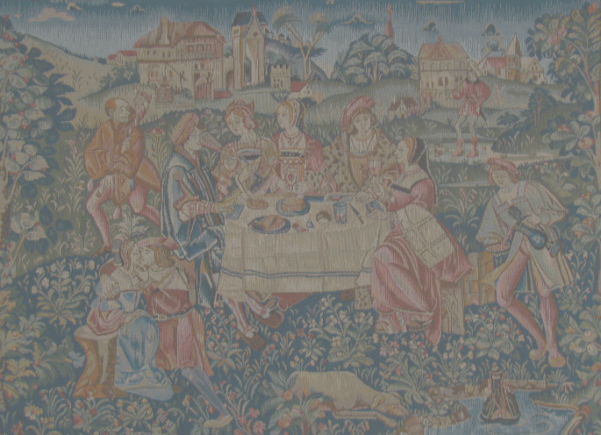
3 Observations
33
“Revelation is a complex vision coming to John. We have to examine all the symbols and put them together to figure it out. It’s like a tapestry woven one thread at a time.”
“Still, there is a level of understanding at which we can read the book of Revelation if we stay within its symbolic interpretation and historical context.”

Slide 34
4 Philosophies of Interpretation
1. Preterist
2. Historicist
3. Futurist
4. Idealist

Slide 35
4 Philosophies of Interpretation
1. Preterist
Study Revelation in its 1st century setting from Nero to Domitian Caesar. Revelation was fulfilled mostly in 1st and 2nd century from fall of Jerusalem to fall of Roman Empire. As such, Revelation has no meaning whatsoever for us today.
2. Historicist
Revelation is a time scheme in the whole course of history. Time scheme spans from now into the future. Time scheme stretches through all time. As such, we can use Revelation to predict secular, historical events from now until the end of time.

Slide 36
4 Philosophies of Interpretation
3. Futurist
Adopted by those who believe in Pre-Millennialistic “Eschatology” (doctrine of “last things”). As such, it is popular with those who believe:
Armageddon is a literal, physical battle
God will defeat his foes via Armageddon
Jesus will reign on earth 1000 years
4. Idealist
Timelessly symbolic. Symbols and meaning do not change with time. The comfort to Christians is that:
God will avenge the Faithful’s blood
The Faithful win the victory
God will save the Faithful from the 2nd death

Slide 37
Detecting Commentator’s Viewpoint
Rev 1:10; 2:10
3:15-16; 14:13
22:18-19
Rev 6:1-4
Rev 12:14
Rev 13:18
Rev 16
Rev 17:10-11
Rev 20:8
Hooked on “Oral Tradition”
Futurist
Potential Preterist
Potential Idealist
Pre-M , Historicist
Futurist
Pre-M , Futurist, Historicist
Notes:
We can identify a person’s belief structure on Revelation by several key verses.
(Not spend much time on this chart)

Slide 38
Homework: Memory Verse
1 John 1:7 (NKJV)
⁷ But if we walk in the light as He is in the light, we have fellowship with one another, and the blood of Jesus Christ His Son cleanses us from all sin.
1 John 1:7 (NKJV)
⁷ But if we walk in the light as He is in the light, we have fellowship with one another, and the blood of Jesus Christ His Son cleanses us from all sin.
Rich Man and Lazarus
Luke 16:19-31
Notes:
Making advanced references to Rich Man and Lazarus

Slide 39
Revelation
Characteristic
Revelation
Characteristic
Revelation
Characteristic
“Revelation Top 10”
“Revelation Top 10”
“Revelation Top 10”

Slide 40
Top 10 Contrasts
Genesis
Revelation
Sun / moon created
Sun not needed (Glory of God)
Sin entered our lives
Sin banished to Lake of Fire
We ran from God
We boldly approach God thru Jesus
Sin’s curse infected
Sin’s curse removed
Sorrow, Tears appeared
God wipes away all tears
Earth became painful & temporal
We have no pain; eternal
Fear defeats us
Fear defeated thru blood of Lamb
Destined to die
Destined to live
Death defeats us
Death and Hades defeated
Hid our face from God
Anticipate seeing God face to face for eternity

